Slide 1
Cavitating Venturi
REP 1 CDR Jack Igoe
Notes:
7 minute presentation, ITAR information redacted

Slide 2
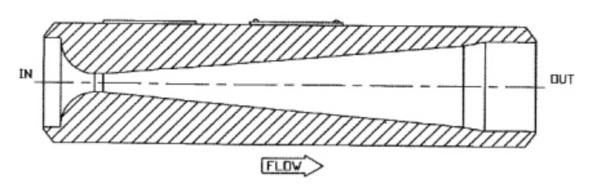
Project Overview
Problem:
Getting propellant into the engine according to propulsion’s requirements
Mass flow rate can be passively regulated with a cavitating venturi
Function:
Decrease throat area to reach vapor pressure and cause cavitation
Cavitation bubbles block the throat and restrict the flow
Difficulties:
Uncertainties
Propulsion error tolerance, operating states, transient conditions
Notes:
Difficulties: passive regulation sensitive to design changes – biggest challenge related to project
Transient conds: also steady state pressure fluctuations within control loop tolerance

Slide 3
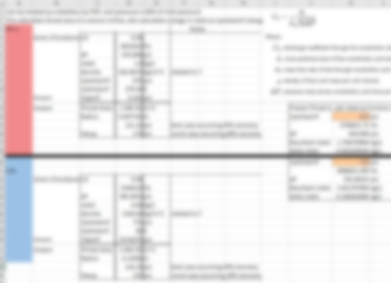

Sizing Calculator
Cd and pressure recovery given by manufacturer
Choose design inputs
Initial pressure sensitivity calculations

Slide 4
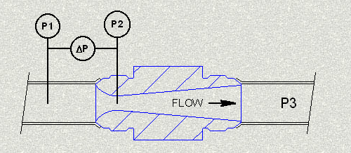
Analysis
MATLAB script
Input temperature and pressure ranges, design inputs
Temperature → vapor pressure (equations pulled from NIST)
Pressure → affects dP

Slide 5
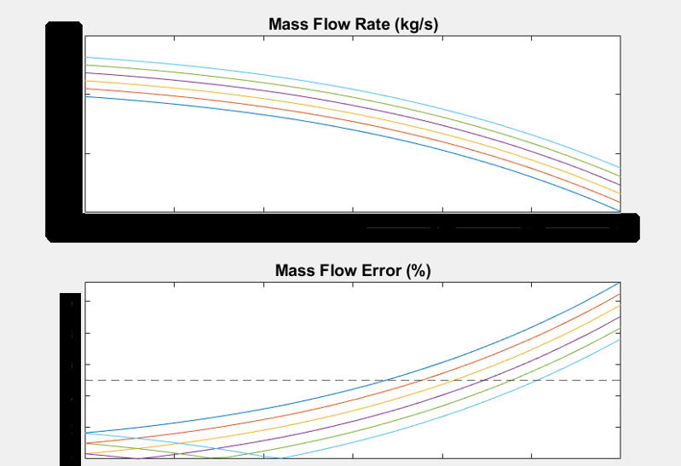
Results Mass flow rate as a function of temperature with incremented pressure values
Notes:
T_range = ITAR
P_range = ITAR

Slide 6
Conclusion
Next Steps
Things I learned
Integrate REFPROP, apply density changes
Cryogenic shrinkage at throat
GFSSP sim
Tests
Engine tolerances are complex
Modularity is the most important goal for this kind of project
Notes:
Modularity: because it’s passive control, small design changes or improved data completely change things. Engine is guaranteed to change-- matter of when and how much, not if

